Slide 1


COMP1030 Lecture #1
Introduction to java

Slide 2
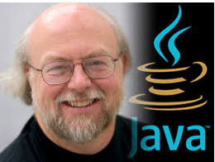
How java came to be
James Gosling
Oak, green, java
Similar to C++ without the liabilities

Slide 3

C++ vs java
C++ java
WOCA WORA
Platform dependent Platform independent
Manual memory management Garbage collection
Operator overloading No operator overloading
No inline documentation javadoc
Supports goto statement goto a reserved word
Pointer arithmetic True Arrays
Unicode not fully supported Unicode fully supported
Changing type sizes Strict Type sizes

Slide 4
Flavours of java
java SE Standard Edition
java EE Enterprise Edition
Java ME Micro Edition
Java Script – nothing to do with java

Slide 5
Java vs java script
java java script
Create applets and application Does not create applets or applications but is embedded in HTML
OOP programming language OOP scripting language
Runs within a browser or the JVM Browser only
Compilation required code is in text – no compilation required
Invented by Sun Microsystems Invented by Netscape

Slide 6
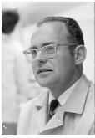
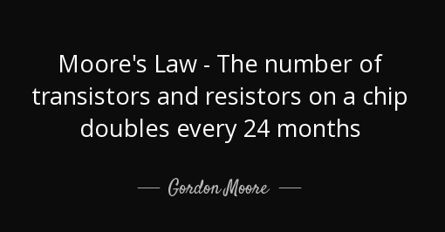
Moores Law
Gordon Moore

Slide 7
Computer Organization
Input Unit
Keyboard, mouse
Output Unit
Monitor
Memory Unit
RAM, ROM
Arithmetic Logic Unit (ALU)
Calculations, comparisons
Central Processing Unit (CPU)
Coordinates operations
Secondary Storage
Hard Drive, DVD

Slide 8
Data Hierarchy
Bits
Character
Fields
Record
File
Database
Big Data

Slide 9
Language Hierarchy
Machine Language
Assembly Language
High Level Languages
Hex codes
Machine dependant
English like abbreviations
load, add, store
Compilers translated statements into machine language
Interpreters eliminate compiling by executing high level statements directly

Slide 10
Partial Language Timeline
1957
Fortran
1959
Cobol
1964
Basic
1969
C
1970
Pascal
1970
Smalltalk (OO)
1983
C++ (OO)
1987
Perl (OO)
1991
Python (OO)
1993
Ruby (OO)
1995
PHP
1995
Java (OO)
1995
Javascript
2005
Ruby on Rails

Slide 11
Characteristics of an OO language
Classes
Object
Encapsulation
Composition
Inheritance
Polymorphism
Re-use
Interfaces

Slide 12
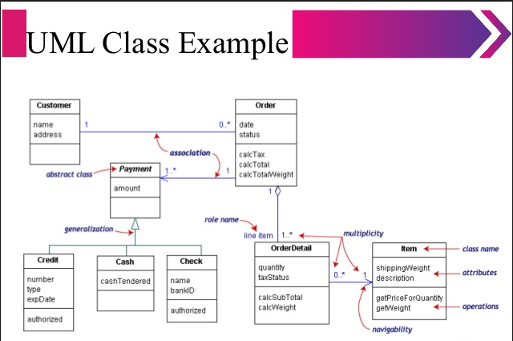
UML – Unified Modeling Language

Slide 13
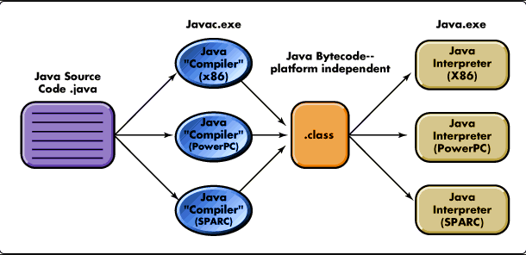
How is java platform independent?

Slide 14
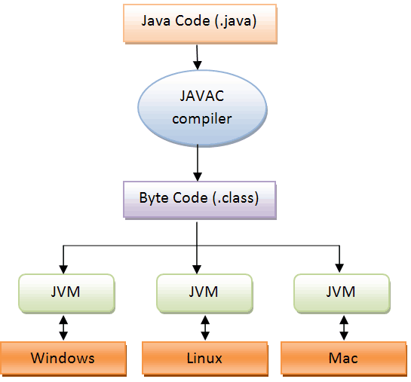
How is java platform independent?

Slide 15
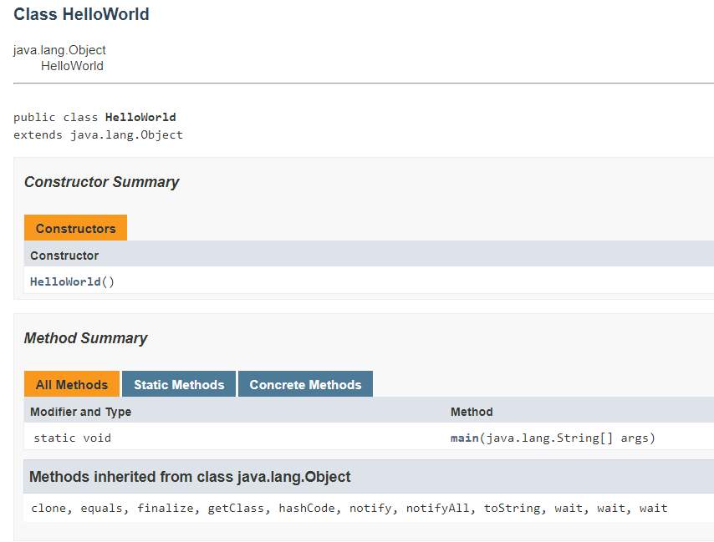
Javadoc –d dir *.java

